Slide 1
Ansible
Configuration Management with Ansible

Slide 2
Outline
Introduction
Ansible architecture
Technical Details
Demo

Slide 3
Outline
Introduction
Ansible architecture
Technical Details
Demo

Slide 4
What is the Problem?!
Configuration management
CM == writing some kind of system state description +
Using a tool to enforce that the servers are in that state
CLI is vendor dependent
NETCONF needs a complicated agent
Ansible exposes a domain-specific language (DSL) that you use to describe the state of your servers
Can also be used for
Deployment and Orchestration

Slide 5
What is Ansible?
IT automation, configuration management and provision tool
It uses playbooks to
deploy, manage, build, test and configure
anything from full server environments to website to custom compiled source code for application
a text file by YAML
Human readable

Slide 6
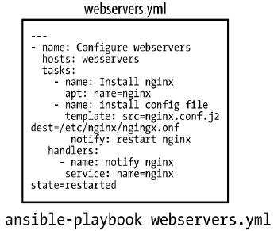
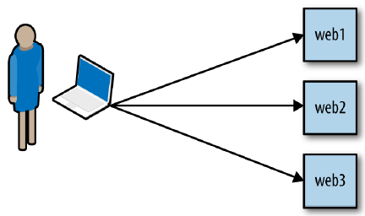
How Does it Work?

Slide 7
Outline
Introduction
Ansible architecture
Technical Details
Demo

Slide 8
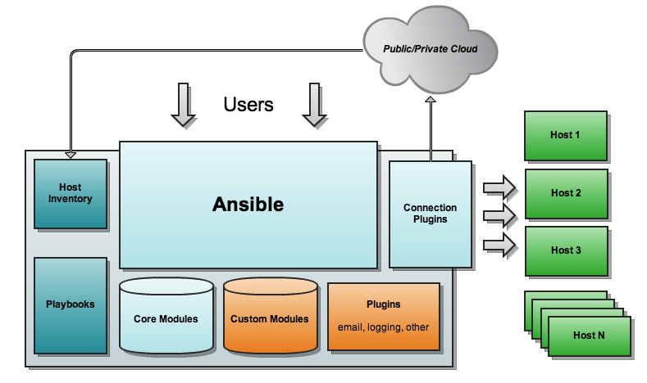
Ansible Architecture

Slide 9
Push Based vs. Pull Based
Tool like Puppet and Chef are pull based
Agents on the server periodically checks for the configuration information from central server (Master)
Ansible is push based
Central server pushes the configuration information on target servers
You control when the changes are made on the servers
Ansible has official support for pull mode, using a tool it ships with called ansible-pull.

Slide 10
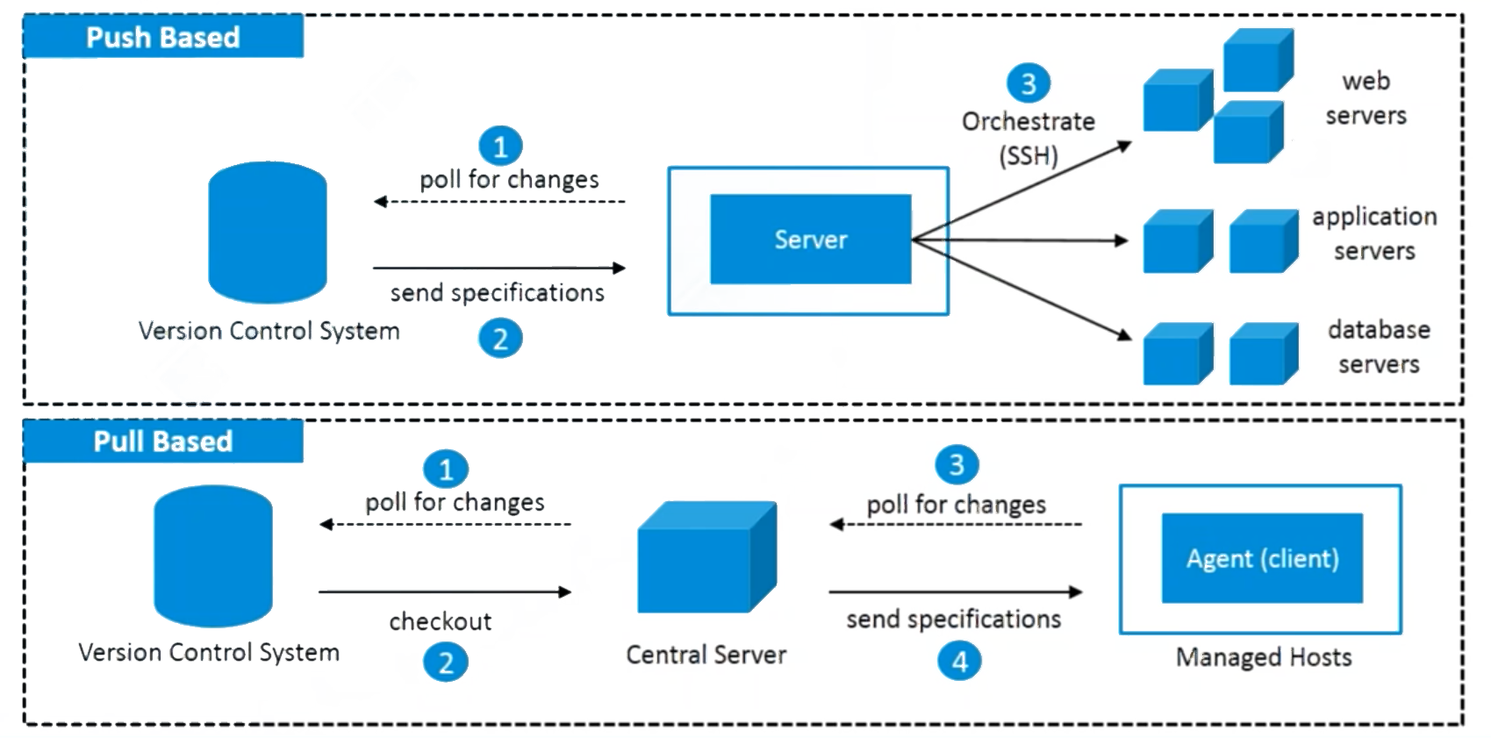
Push Based vs. Pull Based (cont’d)

Slide 11
Outline
Introduction
Ansible architecture
Technical Details
Demo

Slide 12
Host Inventory
Ansible can manage only the servers it explicitly knows about.
Information about devices is provided by specifying them in an inventory file.
Each server needs a name that Ansible will use to identify it. You can use the hostname of the server.
Pass additional arguments to tell Ansible how to connect to it.
Default location is /etc/ansible/hosts

Slide 13
Inventory Example
[tester]
test1 ansible_host=127.0.0.1 ansible_port=22 ansible_user=bahador

Slide 14
Ansible Modules
Modules (also referred as task plugins or library plugins) are the ones which actually get executed inside playbook
These are scripts that come packaged with Ansible and preform some kind of action on a host
Example:
apt: Installs or removes packages using the apt package manager
copy: Copies a file from local machine to the hosts
file: Sets the attribute of a file, symlink, or directory
service: Starts, stops, or restarts a service

Slide 15
YAML Basics
Start of file: ---
Comments: #
List: - <item> or [<item>, <item>]
Dictionary/Mapping: <label>:<value> or {<label>:<value>}
Line Folding: >

Slide 16
YAML Example
---
#This is a description by YAML
name: Ali
family: Hosseini
Address: Iran >
Tehran, …
ID:1111
Courses:
- course_name: abc
course_id: 123
- course_name: xyz
course_id: 456

Slide 17
Ansible Playbook
Ansible’s configuration, deployment, and orchestration language
Written in YAML, declaratively define your configuration
A playbook describes which hosts (what Ansible calls remote servers) to configure, and an ordered list of tasks to perform on those hosts.
Command to run the playbook:
ansible-playbook file.yml

Slide 18
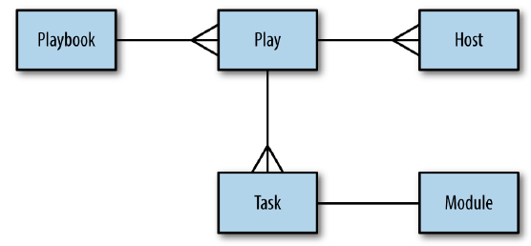
Playbook Structure

Slide 19
Playbook Simple Example
---
- name: a test playbook
hosts: test1
tasks:
- name: check connectivity
ping:
- name: just a touch
command: touch /tmp/123.txt

Slide 20
How Does it Work in Details?
Ansible will do the following:
1. Generate a Python script that installs Nginx package
2. Copy the script to web1, web2, and web3
3. Execute the script on web1, web2, and web3
4. Wait for the script to complete execution on all hosts

Slide 21
Notes on Running Playbook
Ansible runs each task in parallel across all hosts.
Ansible waits until all hosts have completed a task before moving to the next task.
Ansible runs the tasks in the order that you specify them.

Slide 22
Handlers
Handlers usually run after all of the tasks
Handlers are triggered by notify command
They run only once, even if they are notified multiple times.
If a play contains multiple handlers, the handlers always run in the order that they are defined in the handlers section, not the notification order.
The official Ansible docs mention that the only common uses for handlers are for restarting services and for reboots

Slide 23
Handler Simple Example
---
- name: a test playbook
hosts: test1
handlers:
- name: record new
command: touch /tmp/new.txt
tasks:
- name: check connectivity
ping:
- name: just a touch
command: touch /tmp/123.txt
notify: record new

Slide 24
Variables
The simplest way to define variables is to put a vars section in your playbook with the names and values of variables
{{ variable_name }} is substituted by its value
To set the value of a variable based on the result of a task, we create a registered variable using the register clause when invoking a module.
The value of variable is the dictionary, we can access its fields

Slide 25
Variables Simple Example
---
- name: a test playbook
hosts: test1
vars:
target_file: /tmp/123.txt
new_file: /tmp/new.txt
handlers:
- name: save time
shell: echo {{ date_var.stdout }} > {{ new_file }}
- name: get time
command: date
register: date_var
notify: save time
tasks:
- name: just a touch
command: touch {{ target_file }}
notify: get time

Slide 26
Facts
When Ansible gathers facts, it connects to the host and queries it for all kinds of details about the host
CPU architecture
operating system
IP addresses
memory info
…
This information is stored in variables that are called facts, and they behave just like any other variable.

Slide 27
Facts Simple Example
---
- name: Test Facts
hosts: test1
gather_facts: True
tasks:
- debug: var=ansible_distribution
- debug: var=ansible_architecture
- debug: var=ansible_bios_date
- debug: var=ansible_devices

Slide 28
Ansible Features
Easy-to-Read Syntax: built on top of YAML
Agentless: no need for agent installation and management
Built on top of Python and hence provides a lot of Python’s functionality
Uses SSH for secure connections
Follows Push based architecture for sending configurations
Very easy and fast to setup, minimal requirements
Built-in Modules
Ansible modules are declarative; you use them to describe the state you want the server to be in.
Modules are also idempotent. It means that it’s safe to run an Ansible playbook multiple times against a server

Slide 29
Outline
Introduction
Ansible architecture
Technical Details
Demo

Slide 30
Demo
Practical usage of Ansible

Slide 31
References
Hochstein, Lorin, and Rene Moser. “Ansible: Up and Running: Automating Configuration Management and Deployment the Easy Way.” O'Reilly Media, Inc., 2017.

